Slide 1
2. Introduction to DevOps and GitHub
ICT-Training Technical Skills

Slide 2
Introduction to DevOps
DevOps is the acronym given to the combination of Development and Operations.
It refers to a collaborative approach to make the Application Development team and the IT Operations team of an organization to seamlessly work with better communication.
DevOps allows the software or web developers and IT operations to deploy processes in a collaboration session that is entirely blameless.

Slide 3
Devops learning Objectives
Understand what DevOps is and the steps to accomplish it.
Identify teams to implement the process.
Plan for the transformation with shared goals and timelines.
Plan and define timelines for goals.

Slide 4
Introduction to Source Code Management
Source code management (SCM) is used to track modifications to a source code repository.
SCM tracks a running history of changes to a code base and helps resolve conflicts when merging updates from multiple contributors.
SCM is also synonymous with Version control.
It is a software tool that programmers use to manage source code.
It tracks modifications to a source code repository and helps deal with merge conflicts.

Slide 5
Git Installation
Steps For Git Installation on Windows 10
Download and install Git.
Git bash interface.
Basic Git commands.
Create a local repository.
Connect to the remote repository.
Push the file to GitHub.

Slide 6

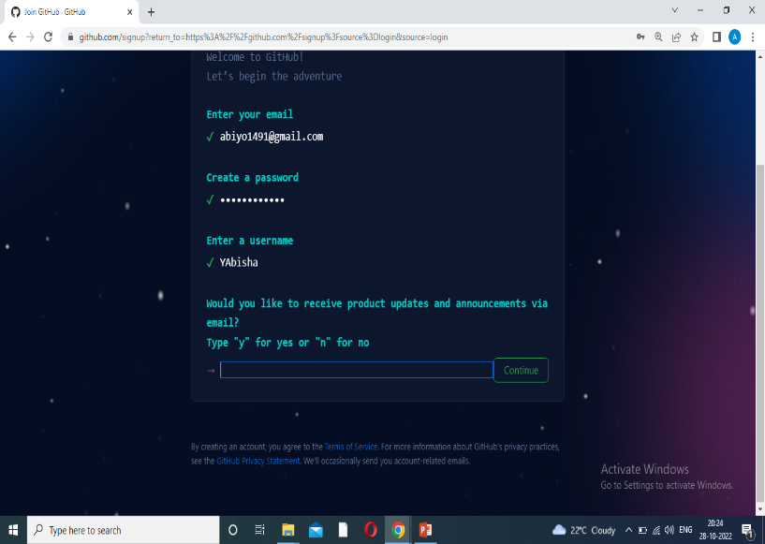
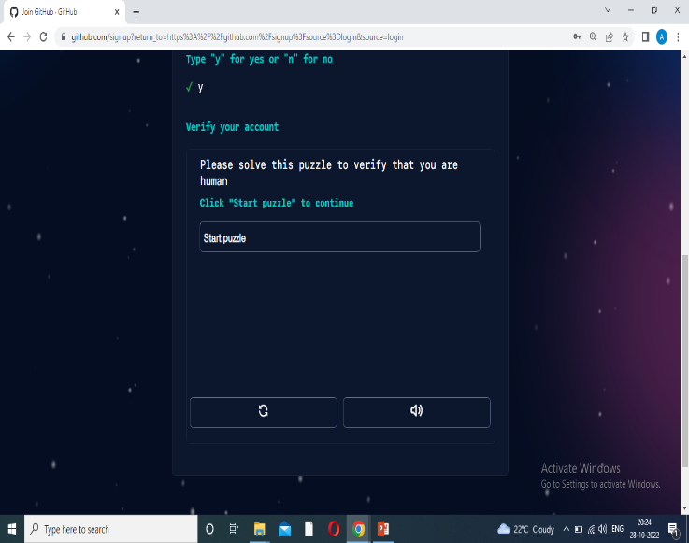
GitHub Account Creation
To sign up for an account on GitHub.com, navigate to https://github.com/ and follow the prompts.
To keep your GitHub account secure you should use a strong and unique password. For more information, see "Creating a strong password.“
Working with repositories -Creating a repository

Slide 7
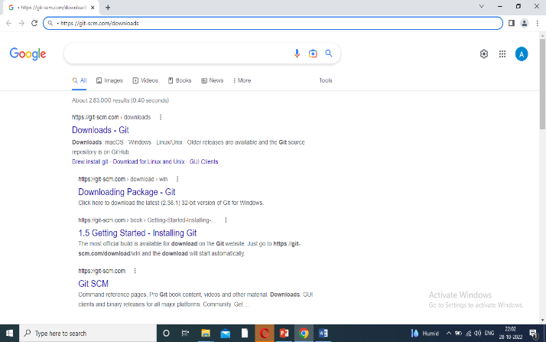
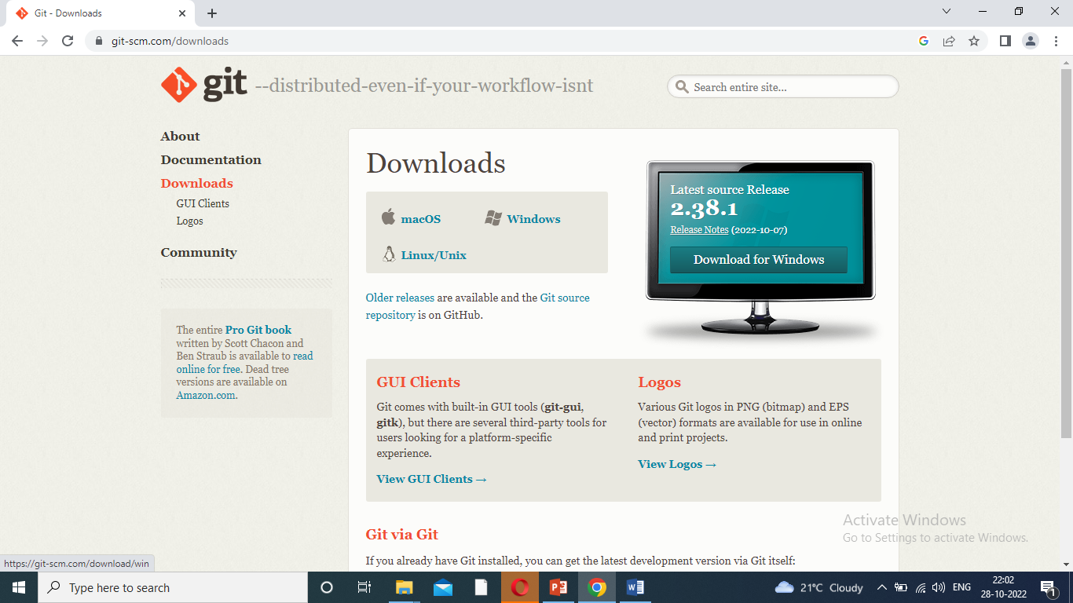
Steps for GitHub Account Creation
GitHub
Cloning GitHub repository in local machine.
Step : 1
Download Git for window.
https://git-scm.com/downloads
SCM – Source Code Management.

Slide 8
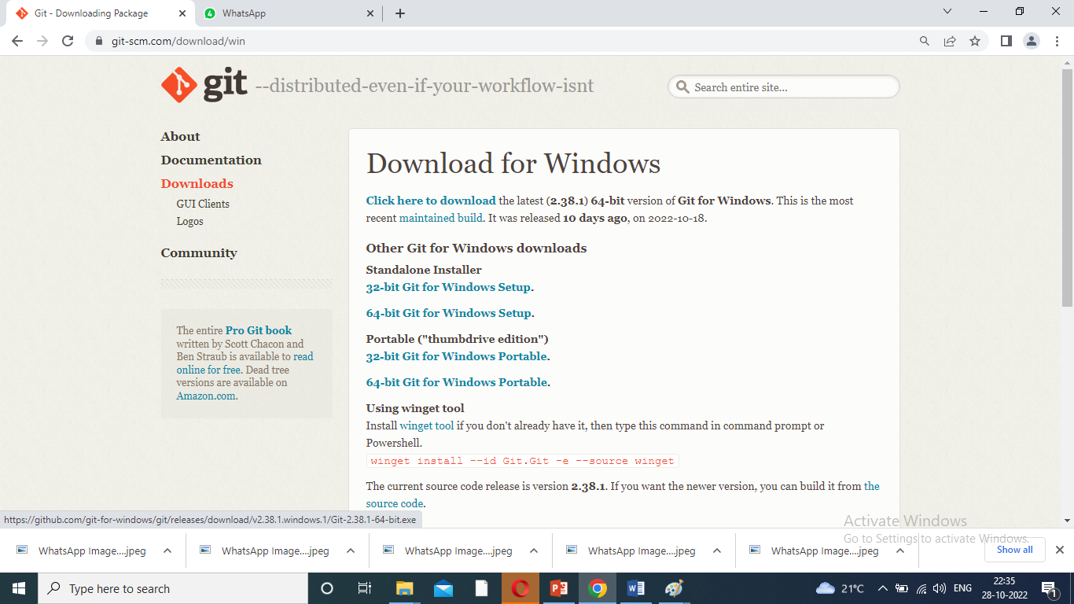
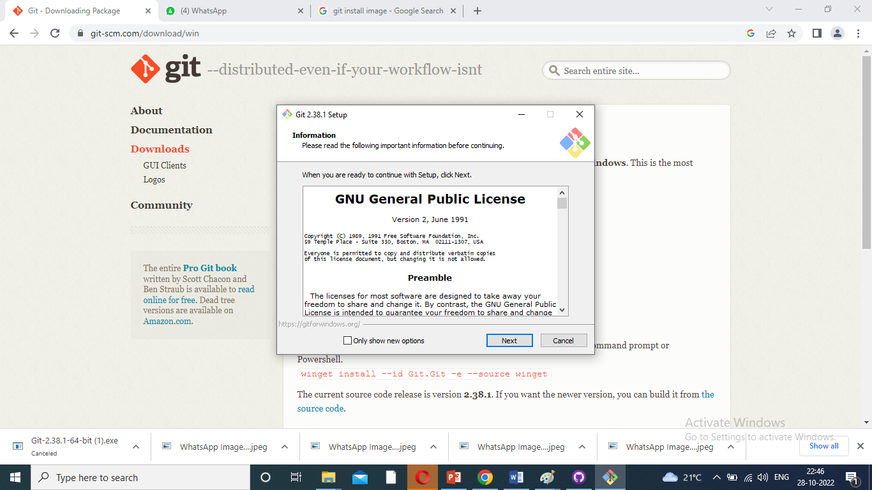
Steps for GitHub Account Creation
Step : 2
Install Git.
Default options are click –next. Then, click install.
GitHub to desktop launching.

Slide 9
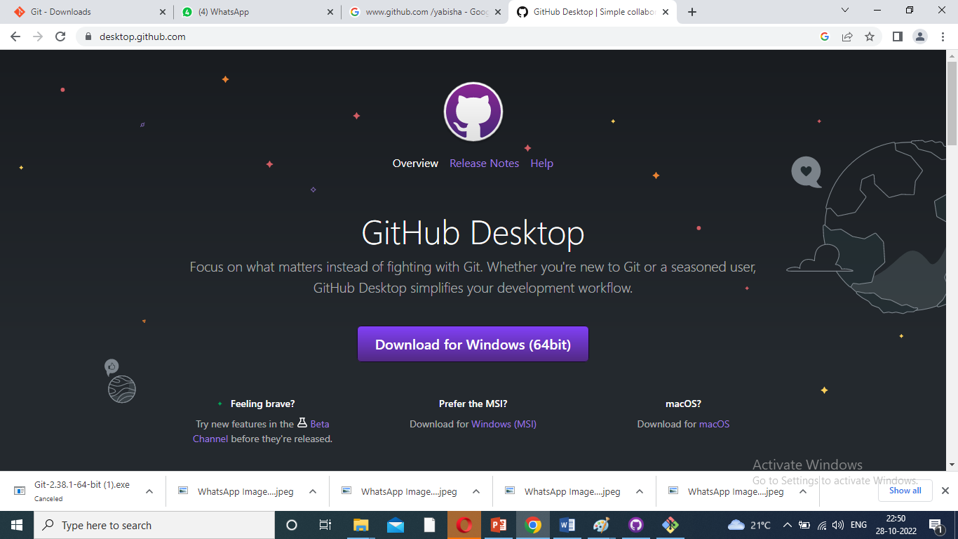
Steps for GitHub Account Creation
Step : 3
Download GitHub Desktop.
https://desktop.github.com
Download for windows.
Install GitHub Desktop.

Slide 10
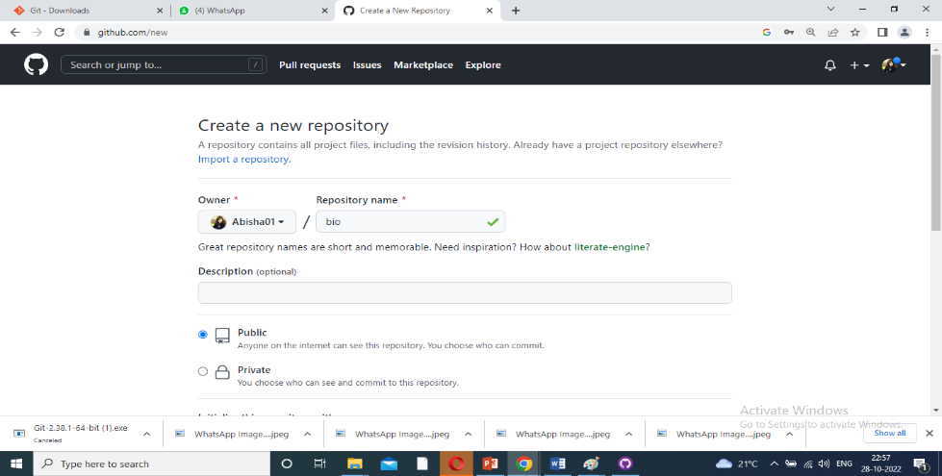
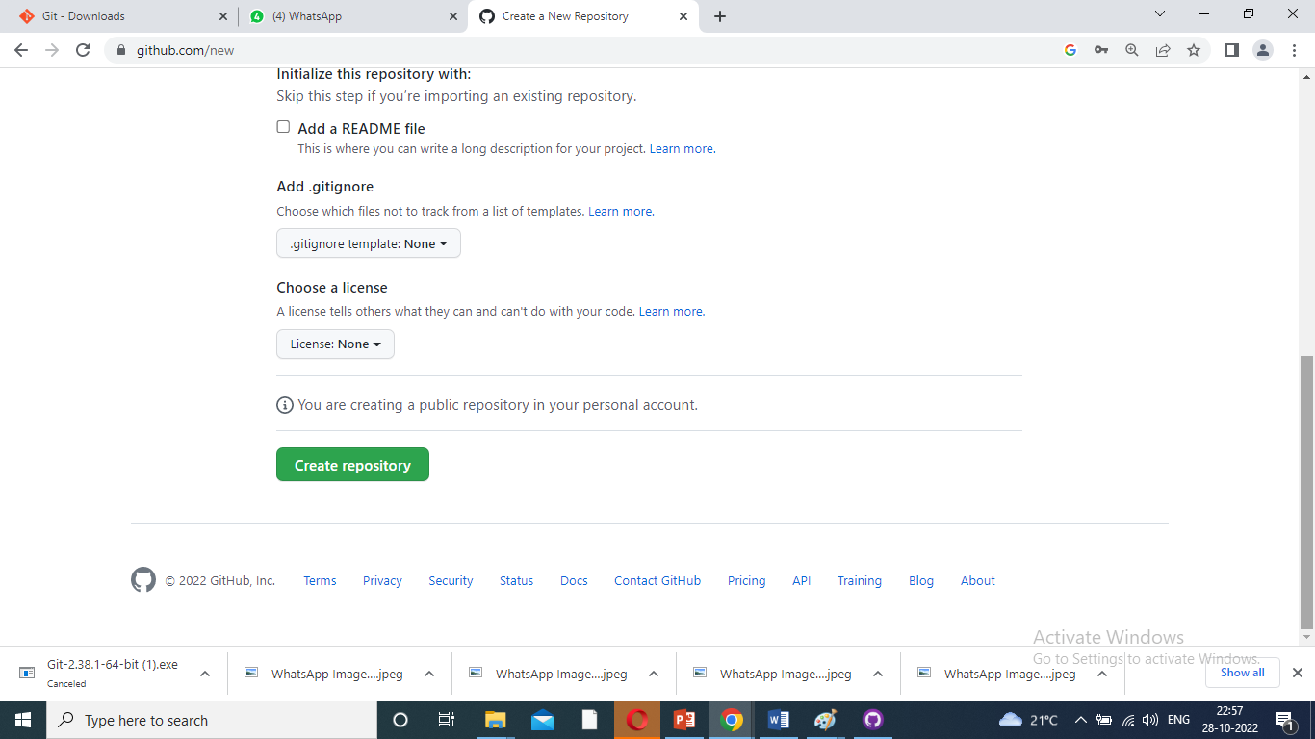
Steps for GitHub Account Creation
Step : 4
Clone repository from the internet.
Repository name – enter/choose path(i.e., bio)- click-clone
Drive c:\ project\ bio - path folder create- same repository name folder create – Our project -save as - repository name folder.
Go to GitHub-click- repository name – view the project details in the GitHub – Push origin.

Slide 11
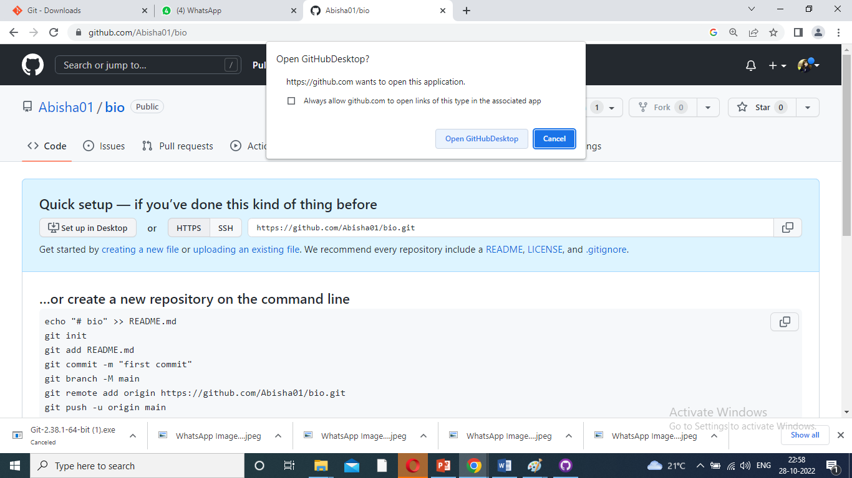
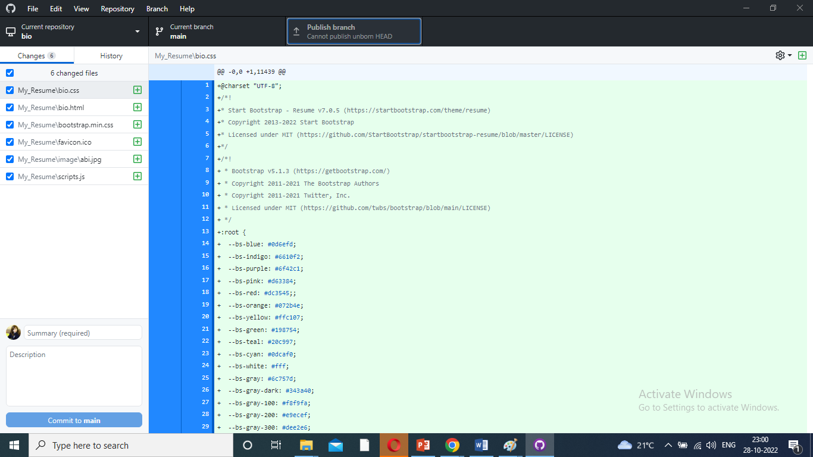
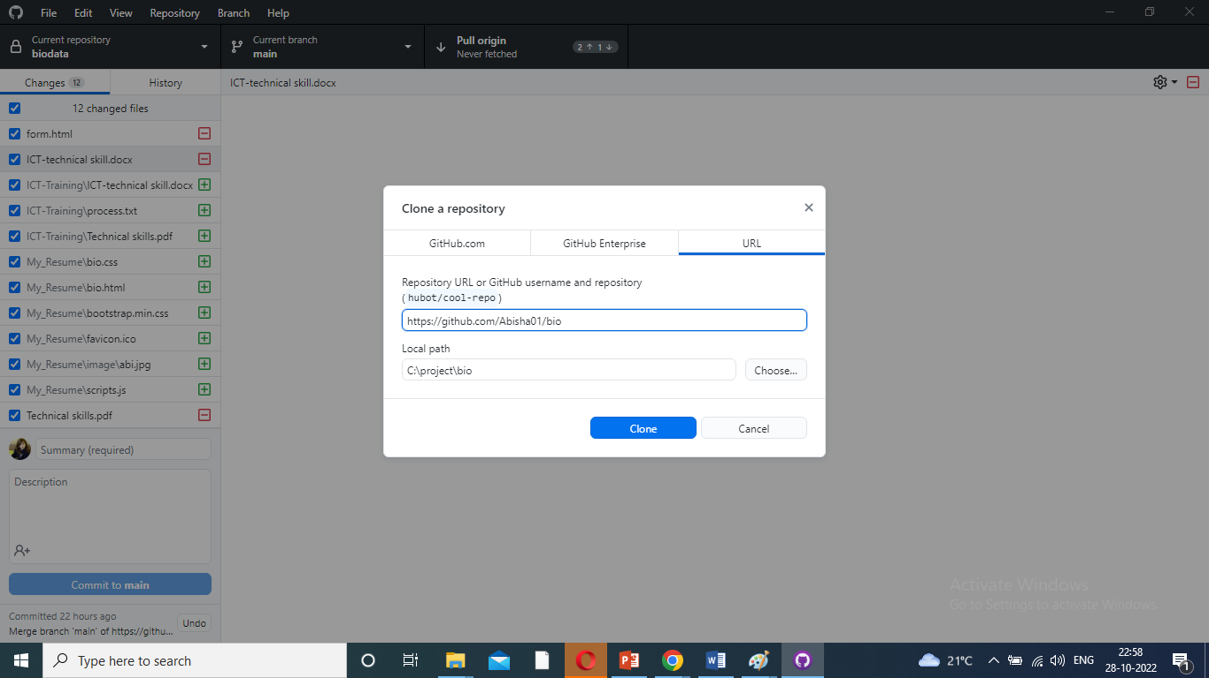
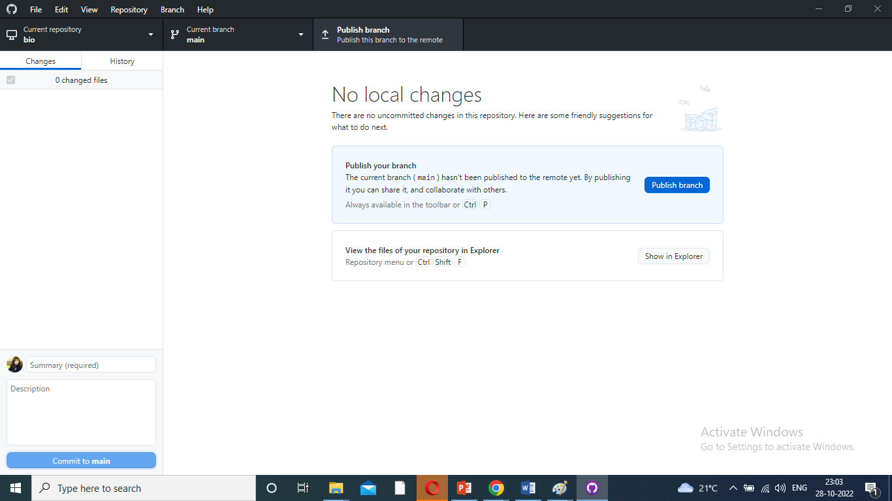
Clone repository from the internet

Slide 12
GitHub Working with repositories
Creating a repository
Cloning a repository
Forking a repository
Importing your projects
Managing collaborators and permissions
Publishing and managing GitHub Packages

Slide 13
Source code management by using GitHub Desktop
Source Code Management (SCM) is a process and set of tools used to keep track of changes to the code files in a source code repository.
The most common type of source code repository in use these days is a directory (folder) on your computer containing a set of code files that make up your project.

Slide 14
Source Tree
Source tree is a fully functional GUI right out of the box that works with Git and Mercurial.
It's compatible with both Windows or Mac operating systems.
Detailed tutorials help you get started quickly.
All commands are accessible with just one click.

Slide 15
Tortoise git
Tortoise Git is a free open-source client for the Git version control system.
That is, Tortoise Git manages files over time.
Files are stored in a local repository.
The repository is much like an ordinary file server, except that it remembers every change ever made to your files and directories.

Slide 16
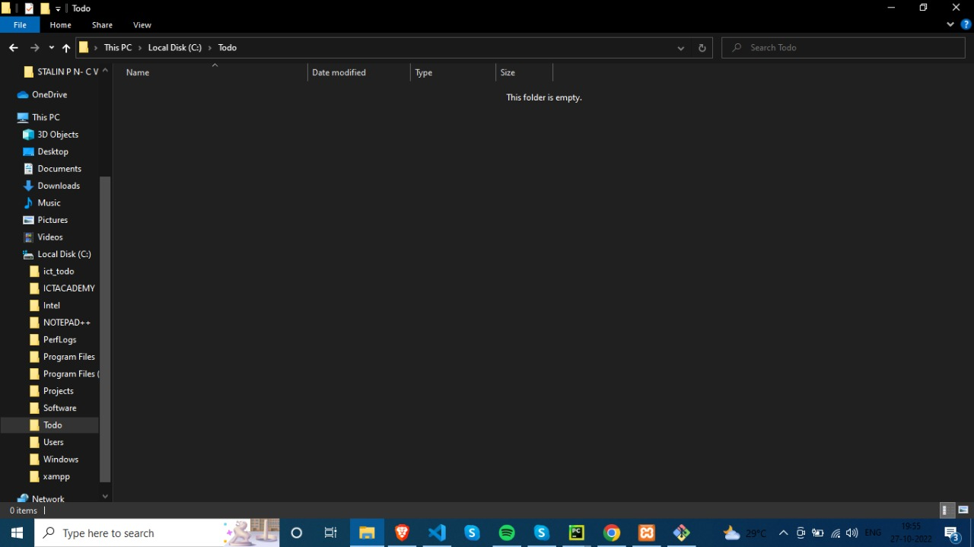
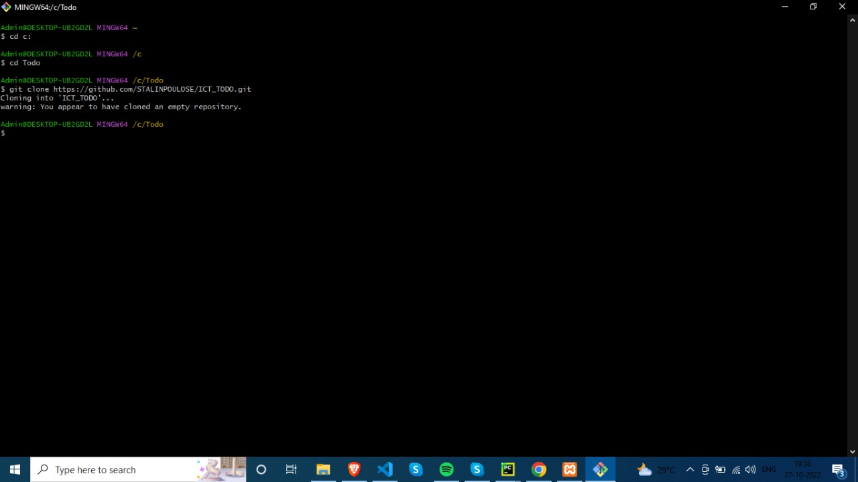

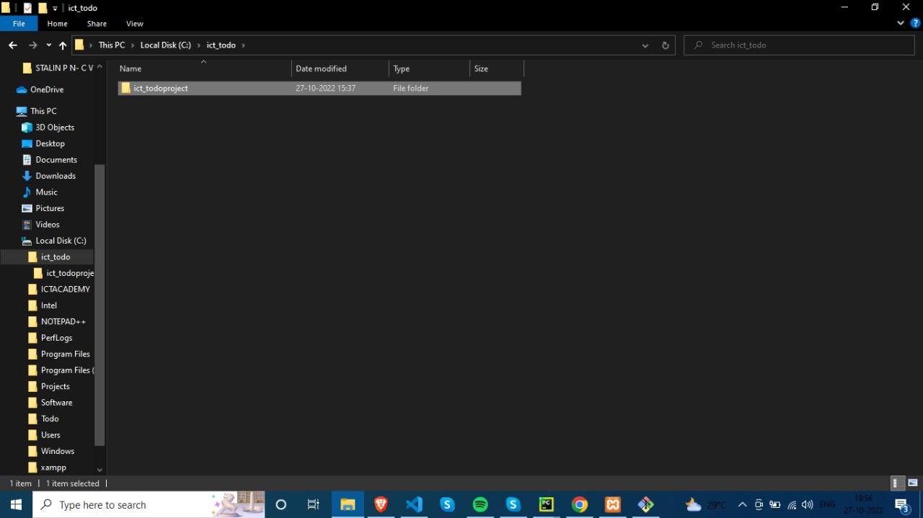
Tortoise git

Slide 17

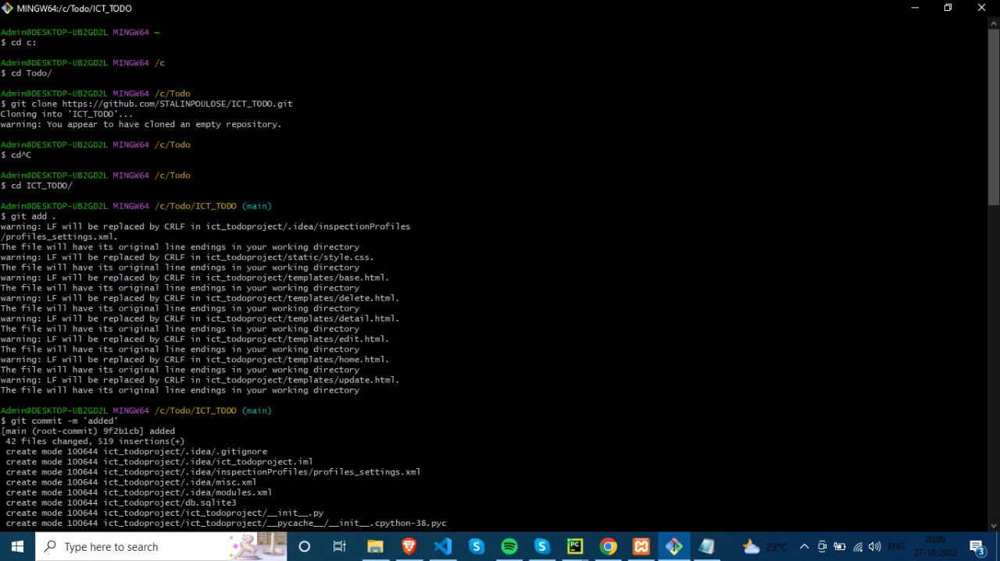
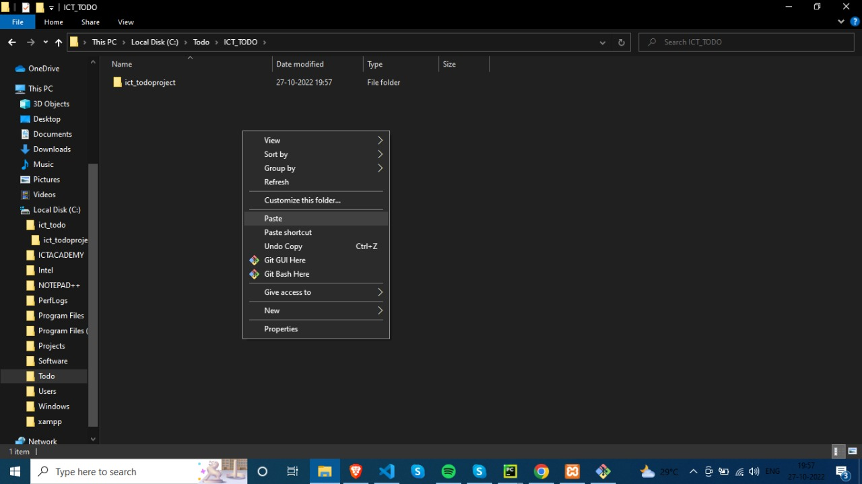
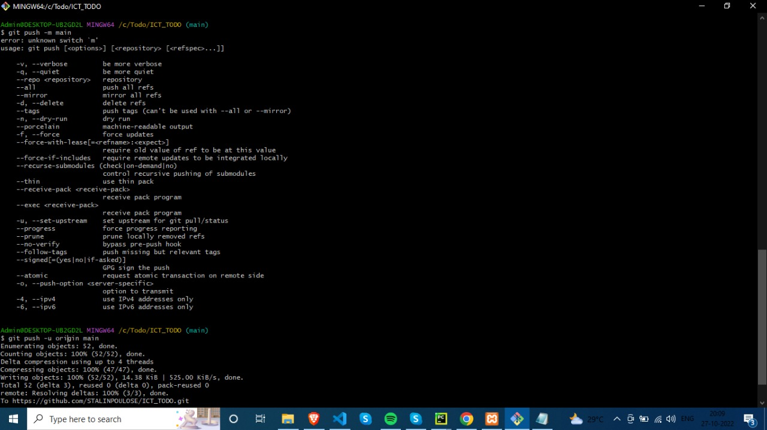
Tortoise git

Slide 18
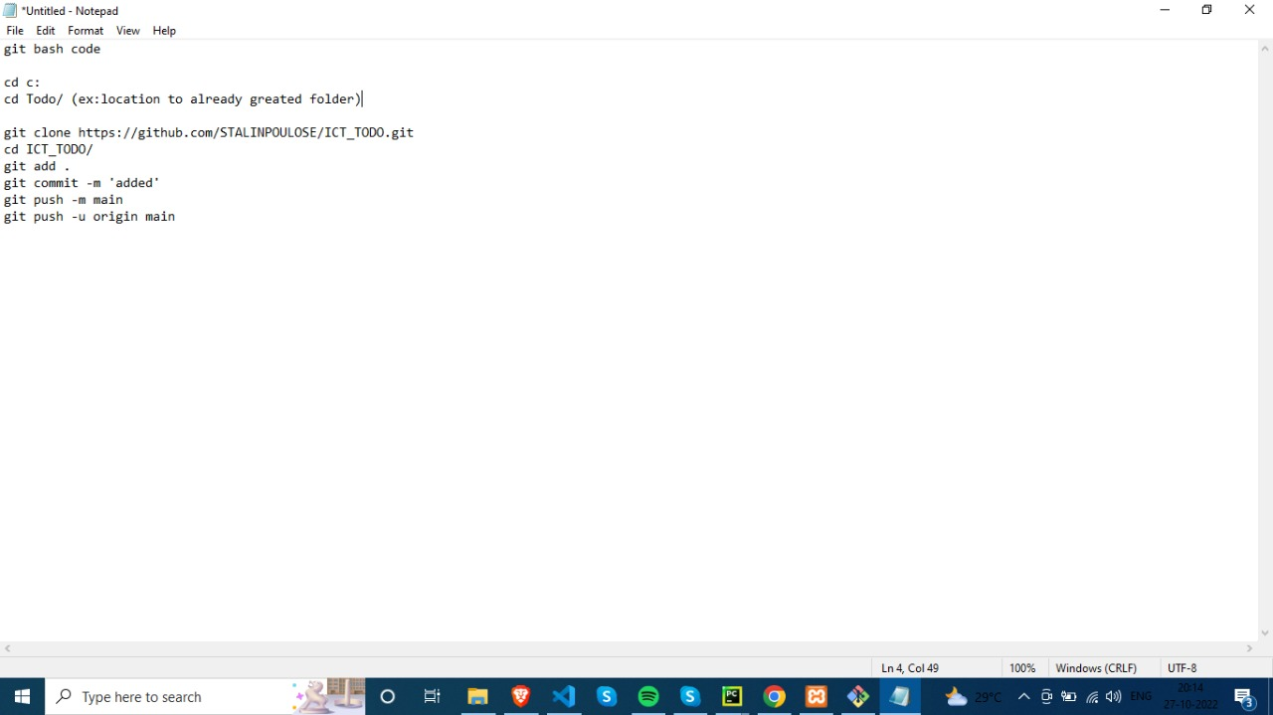
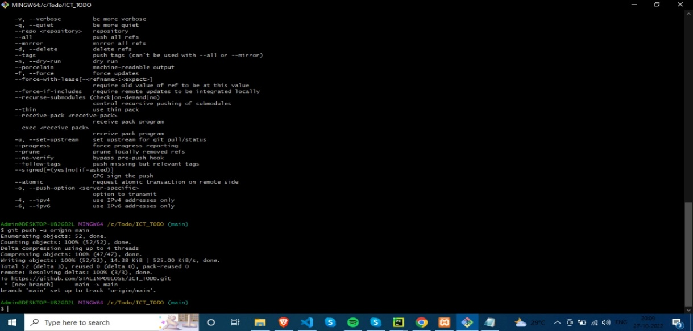
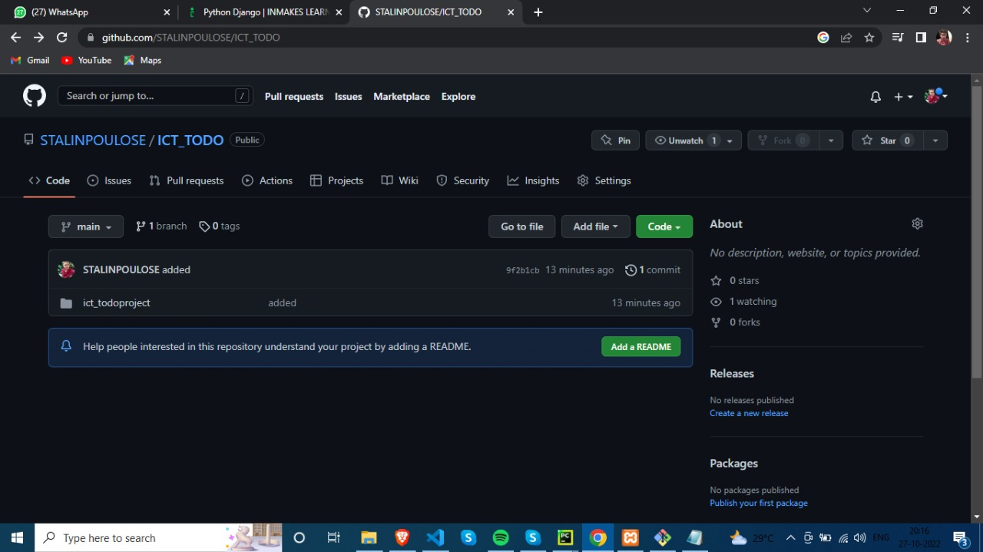
Tortoise git

